Slide 1

Object Dimension Calculator From Images – Python mini group project
Guided By –
Dr. Pallavi Khatri Mam
Madhav Vyas Sir

Slide 2
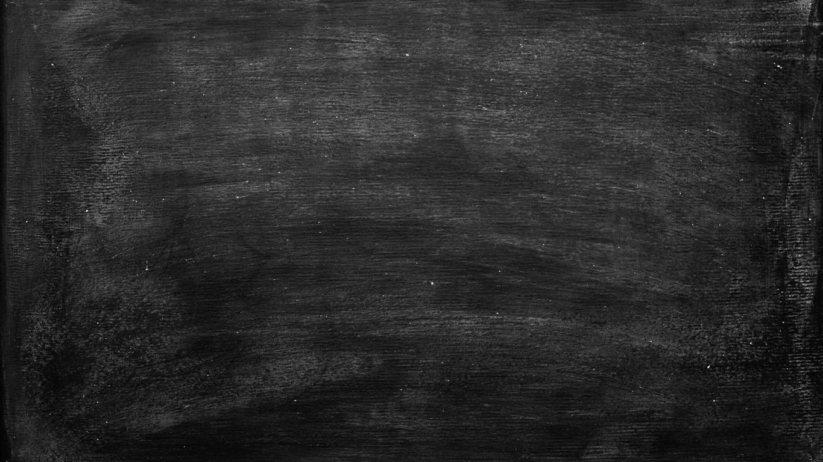
Group Members
Involved in code testing.
- ANJALI SINGH (BETN1CS19080)
Input data collection, Extract necessary data from the output image.
- ANURAG KUMAR SAHU (BETN1CS19081)
Image pre-processing, Implement Canny Edge Method, Contours Detection, code debugging.
- ARYAN GUPTA (BETN1CS19080)

Slide 3
OUTLINES
Introduction to Object Dimension Calculator.
Software Requirements.
Work Flow of the project.
Project Insight.
Edge Detection (Canny Edge Method).
Morphological Operations (Erosion & Dilation)
Contours.
Input & Output Image
Observation Table
Some Real life applications.

Slide 4
Object Dimension Calculator
Object Dimension Calculator is a python program that calculates Actual dimension of objects from an image.
This program gives you approximate average accuracy of 98% , When followed by some prerequisites while capturing an image.

Slide 5
Software Requirements
Python (3.x)
Python Modules & libraries
openCV (1.18.5)
Scipy
Numpy(>=1.17.3)
Imutils

Slide 6
WORK FLOW
Image processing
Edge Detection
Draw &Detect Contours
Some mathematical Calculations
Input Image
Output Image

Slide 7
Project Insight
The Program execution starts when you provide the location of the image from the disk.
Then, the pre-processing of the image takes place and you may also observed some of the frames.
These frames simply give you a clear picture of the intermediate results. Following are the name of the frames:
Input Image Frame. 5. Dilation Frame.
Gray-scale Frame. 6. Erosion Frame.
Blurred Frame. 7. Output Image Frame.
Canny Edge Frame.

Slide 8
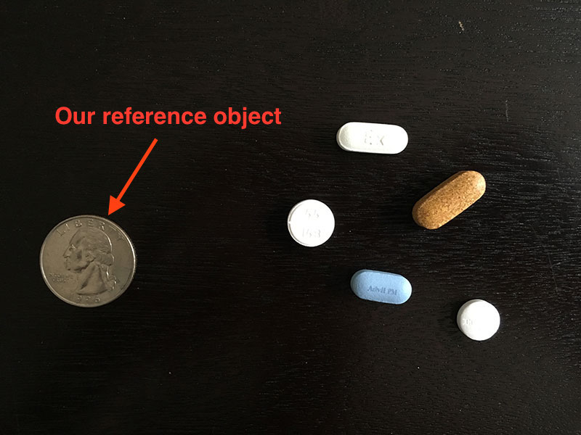
REFERENCE OBJECT APPROACH (Object Detection Method)
This approach is simply based on reference object .
We need to consider a reference object in our input image.
Our reference object should have two important properties which should be known beforehand:
We should know the dimension of this reference object( in terms of cm).
We should be able to find this reference object in an image based on the placement of the object (ensure that our reference object always placed in the left-most part of the image).

Slide 9
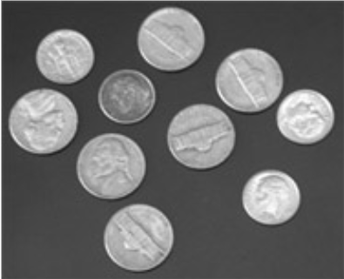
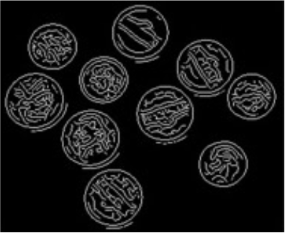
EDGE DETECTION (Canny Edge Method)
Edge Detection is an image processing technique for finding the boundaries of objects within an image. It works by detecting discontinuities in brightness.
Edge Detection is used for image segmentation and data extraction in areas such as in image processing, computer vision, and robotics.
(Edge Detection using Canny method)

Slide 10
Morphological Operations (Dilation & Erosion)
Dilation & Erosion are two fundamental Morphological operations :
DILATION
EROSION
Dilation adds pixels to the boundaries of objects in an image.
It fills the holes and broken areas in an object.
It increases the brightness of the object.
While erosion removes pixels on object boundaries.
It removes the small anomalies.
It reduces the brightness of the bright objects.

Slide 11
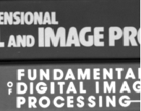
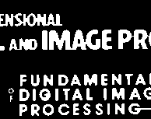
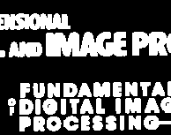
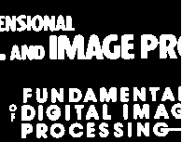
RESULTS AFTER APPLYING DILATION & EROSION
Binary Image
Gray-Scale Image
Dilated Image
Erosion Image

Slide 12
Contours
A contour is a closed curve joining all the continuous points having some color or intensity, they represent the shapes of objects found in an image. Contour detection is a useful technique for shape analysis and object detection and recognition.
The frame we get after the process of erosion & dilation is then passed through the cv2.findContour(), contours.sort_contours(), cv2.drawContours().
Now from the above step we get contours in our frame.
Contours helps to determine the shape & position of objects in the frame.

Slide 13

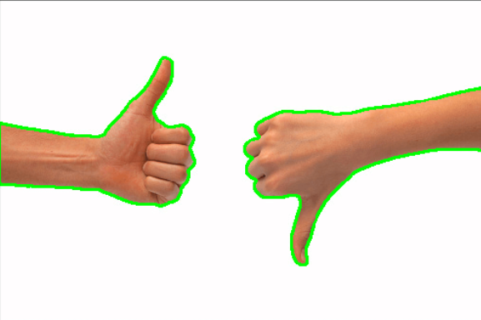
Contours

Slide 14
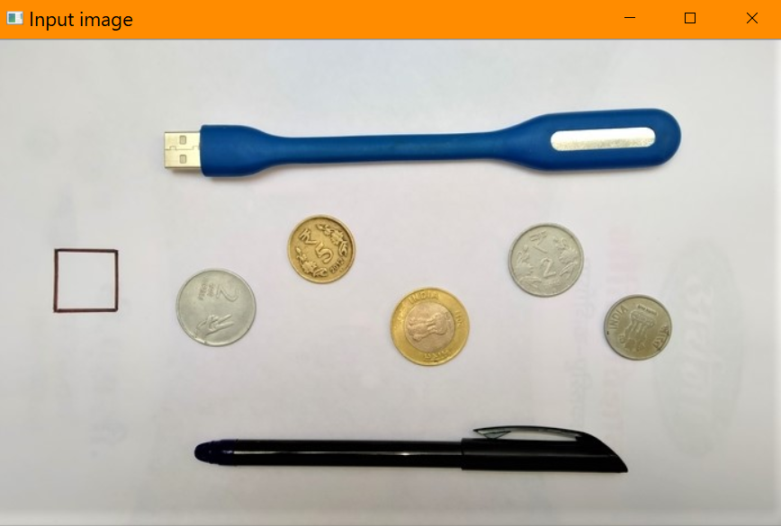
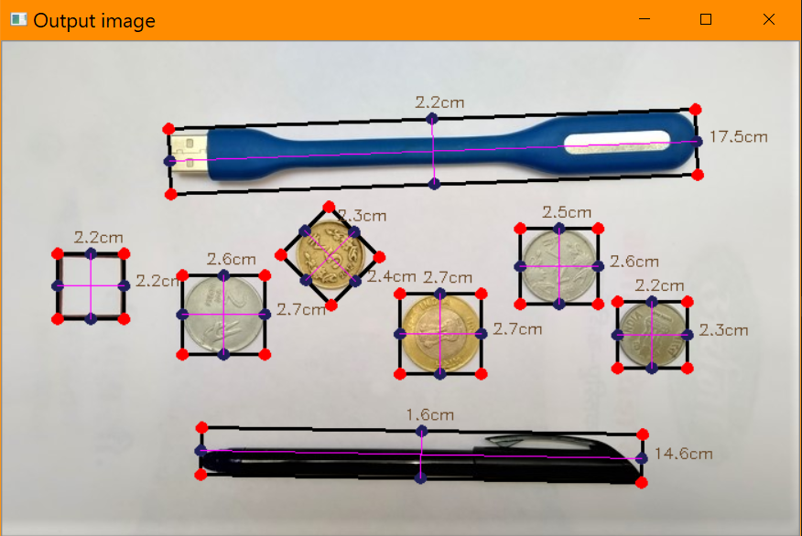
INPUT & OUTPUT IMAGE

Slide 15
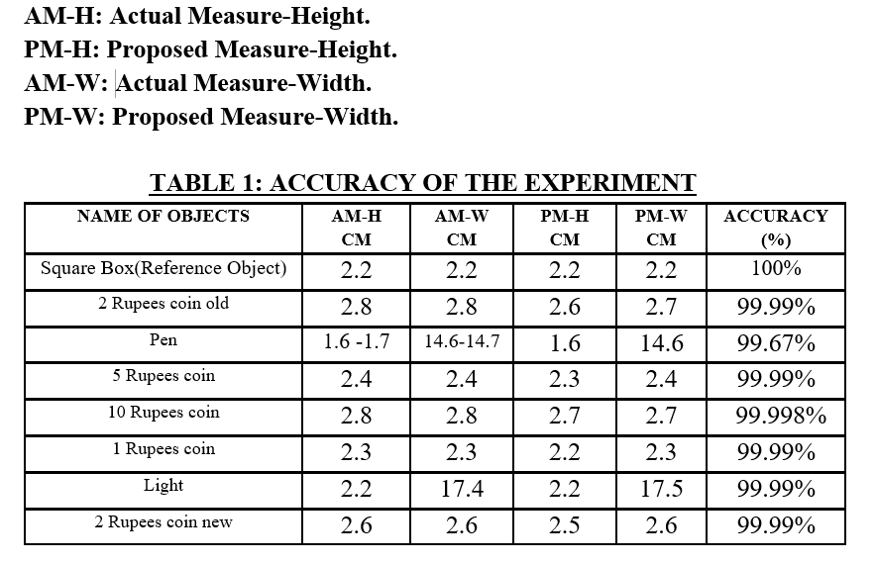
OBSERVATION TABLE

Slide 16
SOME REAL LIFE APPLICATIONS
Measuring object dimension digitally can save the tediousness of performing many day-to-day activities like geometrical calculations involving real life objects.
In many areas of industry we face lots of issues regarding the quality of the product, so the proposed system can be applied to an industrial quality control system to improve the product quality.
This technique can be used in crime scene to investigate the dimensions of objects through an image.
This technique can also be used in the field of robotics.

Slide 17
THANK YOU

